Slide 1
Machine Learning Nanodegree Udacity Connect Intensive
Capstone Proposal
Using Machine Learning to Diagnose Skin Cancer
Ryan Ferrin

Slide 2
Resources
For the Capstone Proposal:
Capstone Proposal Rubric — The criteria against which your capstone project proposal will be assessed.
Capstone Proposal Template — An outline that guides you through the capstone proposal process. The objectives for each of the seven points are laid out, along with a target length for each section.
For the Capstone Report:
Capstone GitHub Repo — A folder containing the capstone proposal & report templates, along with example reports.
Capstone Report Rubric — The criteria against which your Capstone Project final report will be assessed.
Capstone Report Template — An outline for your Capstone Project final report. It’s useful to take a look at this document before doing all of your coding. Writing sections of your report as you accomplish them can make the Capstone Project report less daunting!
Suggested Problem Areas: from the Capstone Project description: "Below are a few suggested problem areas you could explore if you are unsure what your passion is"
Robot Motion Planning
Healthcare
Computer Vision
Education
Investment and Trading
Additional Resources : Platforms hosting data science competitions
https://www.kaggle.com/competitions-
https://devpost.com/hackathons

Slide 3
Capstone Proposal : Project Specifications
CRITERIA | MEETS SPECIFICATIONS
Domain Background | Student briefly details background information of the domain from which the project is proposed. Historical information relevant to the project should be included. It should be clear how or why a problem in the domain can or should be solved. Related academic research should be appropriately cited. A discussion of the student's personal motivation for investigating a particular problem in the domain is encouraged but not required.
Problem Statement | Student clearly describes the problem that is to be solved. The problem is well defined and has at least one relevant potential solution. Additionally, the problem is quantifiable, measurable, and replicable.
Datasets and Inputs | The dataset(s) and/or input(s) to be used in the project are thoroughly described. Information such as how the dataset or input is (was) obtained, and the characteristics of the dataset or input, should be included. It should be clear how the dataset(s) or input(s) will be used in the project and whether their use is appropriate given the context of the problem.
Solution Statement | Student clearly describes a solution to the problem. The solution is applicable to the project domain and appropriate for the dataset(s) or input(s) given. Additionally, the solution is quantifiable, measurable, and replicable.
Benchmark Model | A benchmark model is provided that relates to the domain, problem statement, and intended solution. Ideally, the student's benchmark model provides context for existing methods or known information in the domain and problem given, which can then be objectively compared to the student's solution. The benchmark model is clearly defined and measurable.
Evaluation Metrics | Student proposes at least one evaluation metric that can be used to quantify the performance of both the benchmark model and the solution model presented. The evaluation metric(s) proposed are appropriate given the context of the data, the problem statement, and the intended solution.
Project Design | Student summarizes a theoretical workflow for approaching a solution given the problem. Discussion is made as to what strategies may be employed, what analysis of the data might be required, or which algorithms will be considered. The workflow and discussion provided align with the qualities of the project. Small visualizations, pseudocode, or diagrams are encouraged but not required.
Presentation | Proposal follows a well-organized structure and would be readily understood by its intended audience. Each section is written in a clear, concise and specific manner. Few grammatical and spelling mistakes are present. All resources used and referenced are properly cited.

Slide 4
Presentation
Proposal follows a well-organized structure and would be readily understood by its intended audience. Each section is written in a clear, concise and specific manner. Few grammatical and spelling mistakes are present. All resources used and referenced are properly cited
Machine Learning Engineer Nanodegree: Capstone Proposal Template
Domain Background
Problem Statement
Datasets and Inputs
Solution Statement
Benchmark Model
Evaluation Metrics
Project Design

Slide 5
Domain Background
Student briefly details background information of the domain from which the project is proposed. Historical information relevant to the project should be included. It should be clear how or why a problem in the domain can or should be solved. Related academic research should be appropriately cited. A discussion of the student's personal motivation for investigating a particular problem in the domain is encouraged but not required.
Skin cancer-the most common form of cancer
20% of Americans will develop skin cancer during their lifetime
8,500 people in the U.S. are diagnosed with skin cancer every day
Approximately 5.5 million skin cancer diagnoses
Melanoma accounts for slightly more than 75,000 cases annually
Melanoma: ~1% of skin cancer cases and 70% of skin cancer deaths
13,500 annual deaths from skin cancer in the United States
Skin cancer costs $8.1 billion annually
Melanoma rates doubled in the U.S. from 1982 to 2011, the
Five-year survival rate of melanoma victims is 98% if detected early
https://www.cdc.gov/cancer/skin/statistics/
https://www.aad.org/media/stats/conditions/skin-cancer
http://www.cancer.org/cancer/cancercauses/sunanduvexposure/skin-cancer-facts
https://www.aad.org/media/stats/conditions/skin-cancer

Slide 6
Problem Statement
Student clearly describes the problem that is to be solved. The problem is well defined and has at least one relevant potential solution. Additionally, the problem is quantifiable, measurable, and replicable.
The ultimate goal of this project:
Develop an image recognition model that can identify whether a mole is benign or malignant
Allow people to use a device such as a smartphone, in the comfort of their homes, to aid in the detection of melanoma by simply uploading a photo for analysis
Skin cancer is the most common form of cancer in the United States
this model has the potential to save thousands of lives and billions of dollars annually

Slide 7
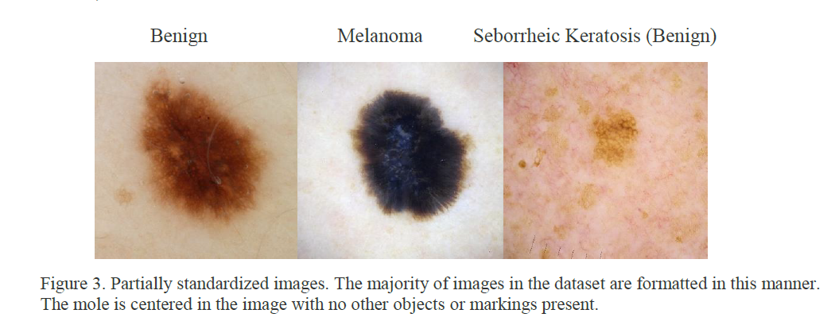
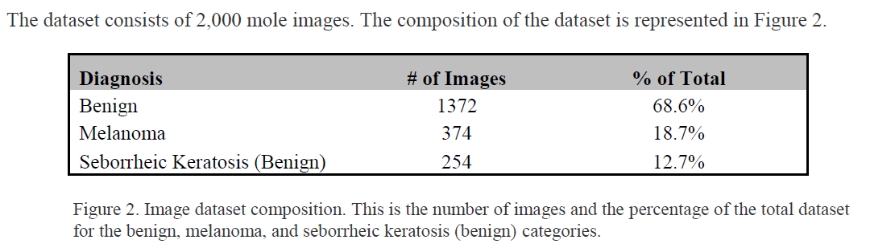
Datasets and Inputs
The dataset(s) and/or input(s) to be used in the project are thoroughly described. Information such as how the dataset or input is (was) obtained, and the characteristics of the dataset or input, should be included. It should be clear how the dataset(s) or input(s) will be used in the project and whether their use is appropriate given the context of the problem.
The dataset used for this project is a collection of 2,000 mole images
The images were obtained from the International Society for Digital Imaging of the Skin’s website.

Slide 8
Solution Statement
Student clearly describes a solution to the problem. The solution is applicable to the project domain and appropriate for the dataset(s) or input(s) given. Additionally, the solution is quantifiable, measurable, and replicable.
Utilize image recognize to diagnosis skin cancer
Recent advances in image recognition machine learning algorithms make the early detection of all skin cancers an achievable goal.
Skin cancer is primarily diagnosed visually, signs include: Changes in size, shape or color of a mole or skin lesion, the appearance of a new growth on the skin, or a sore that does not heal. All of these signs are visual features that can easily be identified, tracked, and monitored by machine vision image recognition algorithms.
This project will be focused on detecting melanoma in moles utilizing the Inveption-v3 image recognition algorithm.
Trained on open-source pre-labeled images of both benign and malignant (melanoma) moles.
Image taken from a smartphone app
Provide probability mole is malignant or benign.

Slide 9
Benchmark Model
A benchmark model is provided that relates to the domain, problem statement, and intended solution. Ideally, the student's benchmark model provides context for existing methods or known information in the domain and problem given, which can then be objectively compared to the student's solution. The benchmark model is clearly defined and measurable.
Benchmark: model > human at diagnosing skin cancer
A typical assessment of a machine learning model’s effectiveness is whether or not it is better than a human performing the same task. In the case of a model focused on diagnosing skin cancer this is a logical strategy. In order for the model to be valuable it likely needs to be at least as effective as the average human physician.
According to a study conducted by Rolfe17, which analyzed the accuracy of 6546 skin biopsies/excisions, physicians had a diagnostic sensitivity (recall) of 76% with respect to melanoma diagnoses.
Benchmark
Recall > 76%

Slide 10
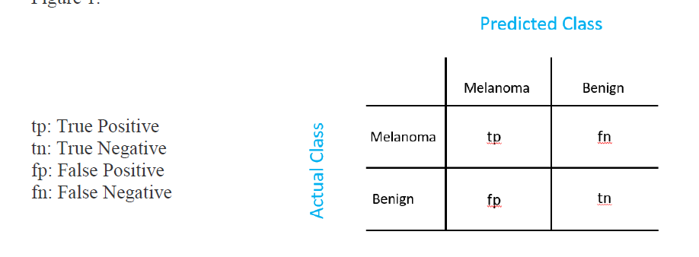
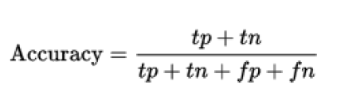
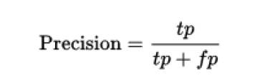
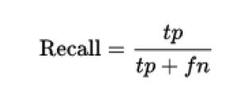
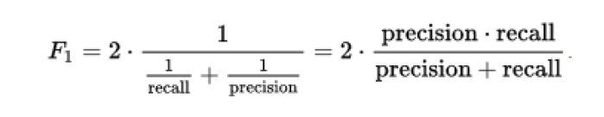
Evaluation Metrics
Student proposes at least one evaluation metric that can be used to quantify the performance of both the benchmark model and the solution model presented. The evaluation metric(s) proposed are appropriate given the context of the data, the problem statement, and the intended solution.
Type II errors are associated with false negatives. In this project it is when a mole is diagnosed as benign but actually has melanoma. These errors are measured by recall; the more type II errors the lower the recall will be and vice versa.
Mole biopsy/excision
Treatment not costly and is relatively safe
Type I errors are not generally an issue
If melanoma is not detected, it can be life-threatening

Slide 11
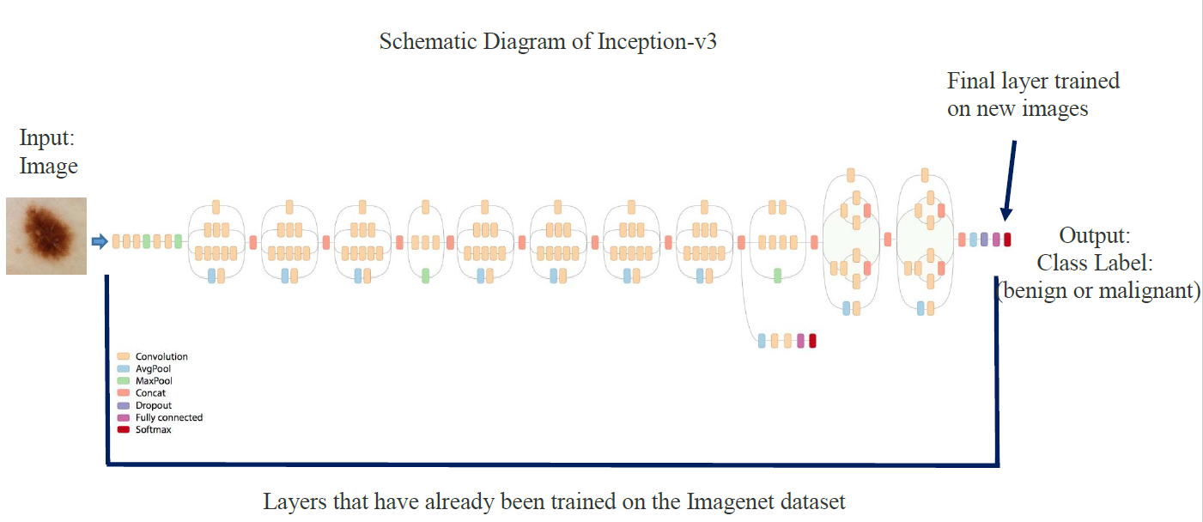
Project Design
Student summarizes a theoretical workflow for approaching a solution given the problem. Discussion is made as to what strategies may be employed, what analysis of the data might be required, or which algorithms will be considered. The workflow and discussion provided align with the qualities of the project. Small visualizations, pseudocode, or diagrams are encouraged but not required
Algorithms and Techniques
Obtain the dataset
Clean the dataset
Download and install model and dependencies
Modify the code with project specifications
Train the model with default hyper-parameters
Test to evaluate model performance
Adjust parameters to maximize performance
Implement model

